Slide 1
statistics
For first stage prepared by Aseel Ali

Slide 2
Correlation coefficients
Correlation coefficients are used to measure how strong a relationship is between two variables. There are several types of correlation coefficient, but the most popular is Pearson’s. Pearson’s correlation (also called Pearson’s R) is a correlation coefficient commonly used in linear regression. Correlation coefficient formulas are used to find how strong a relationship is between data. The formulas return a value between -1 and 1, where:

Slide 3
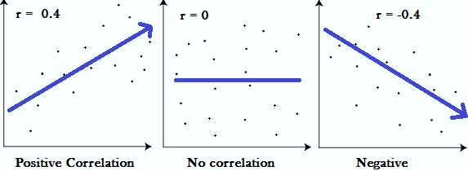
1 indicates a strong positive relationship.
-1 indicates a strong negative relationship.
A result of zero indicates no relationship at all.

Slide 4
Meaning
A correlation coefficient of 1 means that for every positive increase in one variable, there is a positive increase of a fixed proportion in the other. For example, shoe sizes go up in (almost) perfect correlation with foot length.
A correlation coefficient of -1 means that for every positive increase in one variable, there is a negative decrease of a fixed proportion in the other. For example, the amount of gas in a tank decreases in (almost) perfect correlation with speed.
Zero means that for every increase, there isn’t a positive or negative increase. The two just aren’t related.

Slide 5
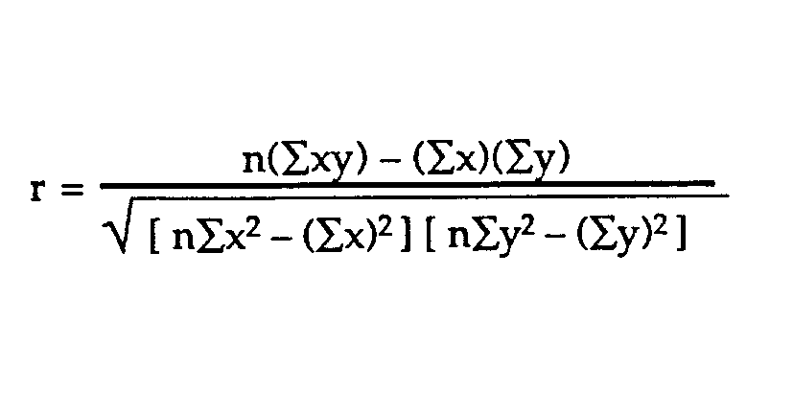
Types of correlation coefficient formulas
There are several types of correlation coefficient formulas. One of the most commonly used formulas is Pearson’s correlation coefficient formula. If you’re taking a basic stats class, this is the one you’ll probably use:

Slide 6
Two other formulas are commonly used: the sample correlation coefficient and the population correlation coefficient.
Sample correlation coefficient
S_{x} and s_{y} are the sample standard deviations, and s_{xy} is the sample covariance.
Population correlation coefficient
The population correlation coefficient uses σ_{x} and σ_{y} as the population standard deviations, and σ_{xy} as the population covariance

Slide 7
What is Pearson Correlation?
Correlation between sets of data is a measure of how well they are related. The most common measure of correlation in stats is the Pearson Correlation. The full name is the Pearson Product Moment Correlation (PPMC). It shows the linear relationship between two sets of data. In simple terms, it answers the question, Can I draw a line graph to represent the data? Two letters are used to represent the Pearson correlation: Greek letter rho (ρ) for a population and the letter “r” for a sample.

Slide 8
Correlation coefficient value
+1 | A complete positive relationship
From 0.70 to 0.99 | A strong positive relationship
From 0.50 to 0.69 | A medium positive relationship
From 0.01 to 0.49 | A weak positive relationship
-1 | A complete negative relationship

Slide 9
Example : Find the value of the correlation coefficient from the following table:
SUBJECT | AGE X | GLUCOSE LEVEL Y
1 | 43 | 99
2 | 21 | 65
3 | 25 | 79
4 | 42 | 75
5 | 57 | 87
6 | 59 | 81

Slide 10
Step 1: Make a chart. Use the given data, and add three more columns: xy, x², and y².
SUBJECT | AGE X | GLUCOSE LEVEL Y | XY | X² | Y²
1 | 43 | 99
2 | 21 | 65
3 | 25 | 79
4 | 42 | 75
5 | 57 | 87
6 | 59 | 81

Slide 11
Step 2: Multiply x and y together to fill the xy column. For example, row 1 would be 43 × 99 = 4,257.
SUBJECT | AGE X | GLUCOSE LEVEL Y | XY | X² | Y²
1 | 43 | 99 | 4257
2 | 21 | 65 | 1365
3 | 25 | 79 | 1975
4 | 42 | 75 | 3150
5 | 57 | 87 | 4959
6 | 59 | 81 | 4779

Slide 12
Step 3: Take the square of the numbers in the x column, and put the result in the x² column.
SUBJECT | AGE X | GLUCOSE LEVEL Y | XY | X² | Y²
1 | 43 | 99 | 4257 | 1849
2 | 21 | 65 | 1365 | 441
3 | 25 | 79 | 1975 | 625
4 | 42 | 75 | 3150 | 1764
5 | 57 | 87 | 4959 | 3249
6 | 59 | 81 | 4779 | 3481

Slide 13
Step 4: Take the square of the numbers in the y column, and put the result in the y² column.
SUBJECT | AGE X | GLUCOSE LEVEL Y | XY | X² | Y²
1 | 43 | 99 | 4257 | 1849 | 9801
2 | 21 | 65 | 1365 | 441 | 4225
3 | 25 | 79 | 1975 | 625 | 6241
4 | 42 | 75 | 3150 | 1764 | 5625
5 | 57 | 87 | 4959 | 3249 | 7569
6 | 59 | 81 | 4779 | 3481 | 6561

Slide 14
Step 5: Add up all of the numbers in the columns and put the result at the bottom of the column. The Greek letter sigma (Σ) is a short way of saying “sum of” or summation.
SUBJECT | AGE X | GLUCOSE LEVEL Y | XY | X² | Y²
1 | 43 | 99 | 4257 | 1849 | 9801
2 | 21 | 65 | 1365 | 441 | 4225
3 | 25 | 79 | 1975 | 625 | 6241
4 | 42 | 75 | 3150 | 1764 | 5625
5 | 57 | 87 | 4959 | 3249 | 7569
6 | 59 | 81 | 4779 | 3481 | 6561
Σ | 247 | 486 | 20485 | 11409 | 40022

Slide 15
Step 6: Use the following correlation coefficient formula.
The answer is: 2868 / 5413.27 = 0.529809

Slide 16
From our table:
$Σx = 247$
$Σy = 486$
$Σxy = 20,485$
$Σx2 = 11,409$
$Σy2 = 40,022$
n is the sample size, in our case = 6
The correlation coefficient =
$$6(20,485) – (247 × 486) / [√[[6(11,409) – (2472)] × [6(40,022) – 4862]]] = 0.5298$$
The range of the correlation coefficient is from -1 to 1. Our result is 0.5298 or 52.98%, which means the variables have a medium positive correlation.

Slide 17
Exercise: For the following data
Find:
1-The correlation coefficient between the two variables x and y.
2-The type of correlation between the variables x and y and the degree of correlation.
x | 3 | 1 | 5 | 2 | 4
y | 3 | 2 | 6 | 4 | 5

